Slide 1



Protective and obesogenic early feeding practices
Monica Hunsberger

Slide 2
Objectives
Review the protective and obesogenic early feeding practices in the literature
Present finding from the Identification and prevention of Dietary- and lifestyle-induced health EFfects In Children and infantS (IDEFICS) study
Share directions we are taking with I.Family

Slide 3
Methods
Review of the literature through mid April 2015
&
Three IDEFICS studies ...
A multi-centre study in eight countries examining risks for overweight/obesity in over 16,000 children
In the IDEFICS cohort, exclusive breastfeeding across the eight participating survey countries was examined in relation to overweight.
In the Swedish IDEFICS cohort (n=1837) we examined introduction to välling, a uniquely Swedish milk cereal drink (MCD).
Introduction to solids, children 2 to 9 years of age (n=11657) were included. Assessment of the odds of being overweight during early childhood and early feeding practices.
Notes:
In both studies, children for whom early feeding practices were described at baseline and weight and height were recorded are included. In the välling study, we included children who had both baseline and two year follow-up anthropometric measures. The children were 2-9 years old at the 2007-2008 baseline and 4-11 years old at follow-up.

Slide 4
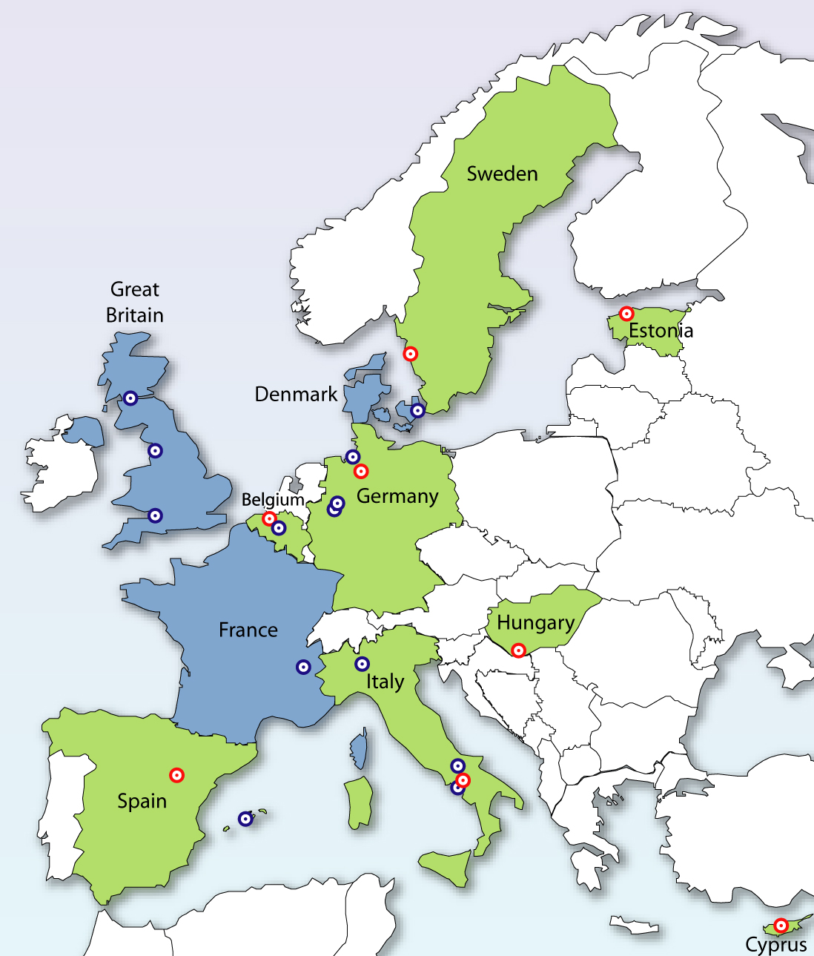
Baseline examination
2007/2008
Follow-up examination
2009/2010
Continuation as I.Family
2012 -2017

Slide 5
What is recommended?
“Infants should be exclusively breastfed for the first six months of life to achieve optimal growth, development and health. After six months, they should be fed adequate and safe complementary foods while continuing breastfeeding for up to two years or beyond.”¹
“For the first six months, breast milk or infant formula is the best food for your child. Breast milk contains all the nutrition a child needs to grow and develop during the first six months…except vit.D, which your child needs to get through vit.D drops .”²
http://www.who.int/features/qa/57/en/
http://www.livsmedelsverket.se/globalassets/english/food-habits-health-environment/dietary-guidelines/good-food-for-infants-under-one-year.pdf
Notes:
But the only food is not emphasized

Slide 6
What is recommended (2)?
“In Australia, it is recommended that infants are exclusively breastfed until around 6 months of age when solid foods are introduced, and that breastfeeding is continued until 12 months of age and beyond, for as long as the mother and child desire.”
“The American Academy Pediatrics recommends that babies be exclusively breastfed for about the first 6 months of life. This means your baby needs no additional foods (except Vitamin D)…”
https://www.nhmrc.gov.au/_files_nhmrc/publications/attachments/n56_infant_feeding_guidelines.pdf
https://www2.aap.org/breastfeeding/faqsBreastfeeding.html

Slide 7
Prevalence of overweight and breastfeeding
WHO Report- Long-term effects of breastfeeding: A SYSTEMATIC REVIEW
Bernardo L. Horta, MD, PhD & Cesar G. Victora, MD, PhD
Published 2013 with data through 2010
Key finding: an association between breastfeeding and lower prevalence of overweight/obesity later in life was observed
Subjects who were breastfed were less likely to be considered as overweight/obese [pooled odds ratio: 0.76 (95% confidence interval: 0.71; 0.81)].
Conclusion: meta-analysis of higher quality studies suggests a reduction of about 10% in the prevlence of overweight due to longer duration of breastfeeding
http://apps.who.int/iris/bitstream/10665/79198/1/9789241505307_eng.pdf
Notes:
The Prevalence of overweight and breastfeeding was extensively reviewed in a WHO report published in 2013. This report covered studies up to 2010. In this summary of the evidence, breastfeeding was protective although the association was modest, a lower prevalence of overweight was observed.

Slide 8
Select studies since the WHO review (1)
A German study (2015) analyzed retrospectively collected data on breastfeeding from children aged 3–17 years who participated in the German Health Interview and Examination Survey for Children and Adolescents (KiGGS baseline study) between 2003 and 2006 (n = 13163).
Authors applied propensity score matching and multivariate logistic regression analyses to estimate the effect of breastfeeding on childhood overweight and obesity.
Findings support a protective effect of breastfeeding.
Notes:
Since the WHO report there have been a handful of studies ..
Academic Editor: Jennifer L. Baker, Institute of Preventive Medicine, DENMARK

Slide 9
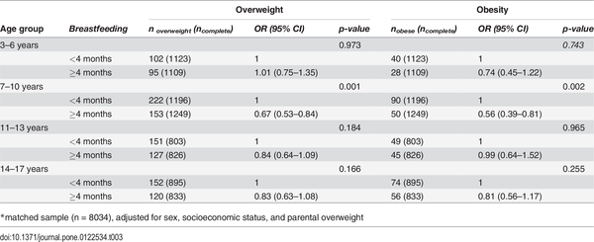
Association between breastfeeding and childhood overweight and obesity, stratified by age groups
Grube MM, von der Lippe E, Schlaud M, Brettschneider AK (2015) Does Breastfeeding Help to Reduce the Risk of Childhood Overweight and Obesity? A Propensity Score Analysis of Data from the KiGGS Study. PLoS ONE 10(3): e0122534. doi:10.1371/journal.pone.0122534
http://127.0.0.1:8081/plosone/article?id=info:doi/10.1371/journal.pone.0122534
Notes:
From the authors table – we can see the effect seems to be strongest in children of primary school age.

Slide 10
A study of Modifiable Early-life risk factors (2)
Risk factor | n | Prevalence %
Maternal obesity before pregnancy ¹ | 135 | 14
Excessive gestational weight gain² | 474 | 48
Smoked in pregnancy | 140 | 14
Low vitamin D status in pregancy³ | 531 | 54
Not breastfed or short duration of breastfeeding⁴ | 355 | 36
BMI>30kg/m2
Institute of medicine 2009 categorization
Serum D concentration in late pregnancy <64 mmol/L
Never breastfed or <1 month completed breastfeeding
Siân M Robinson et al. Am J Clin Nutr 2015;101:368-375

Slide 11
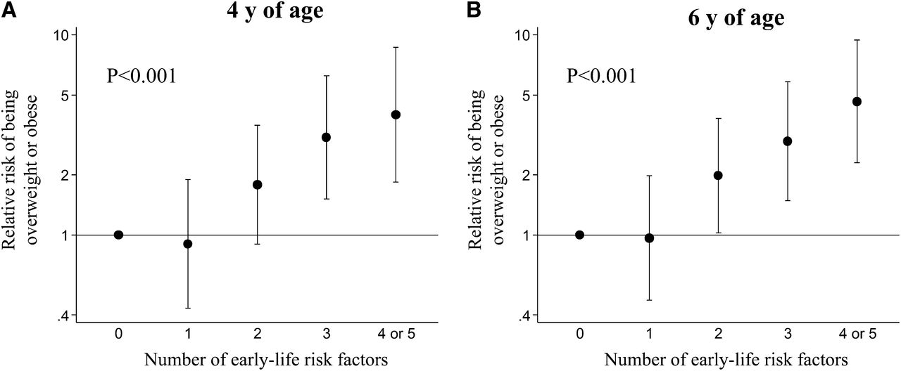
Relative risk (95% CI) of being overweight or obese at 4 and 6 y of age [defined by using IOTF cutoffs
Siân M Robinson et al. Am J Clin Nutr 2015;101:368-375
©2015 by American Society for Nutrition
Notes:
Relative risk (95% CI) of being overweight or obese at 4 and 6 y of age [defined by using IOTF cutoffs (22)], according to number of early-life risk factors (number of children: 116 at 4 y and 109 at 6 y with no risk factors, 233 at 4 y and 251 at 6 y with 1 risk factor, 200 at 4 y and 224 at 6 y with 2 risk factors, 102 at 4 y and 119 at 6 y with 3 risk factors, and 37 at 4 y and 46 at 6 y with 4 or 5 risk factors). Data are adjusted for child's gestational age at birth, as well as maternal height, education, parity, and age at child's birth. P values were determined by Poisson regression models with robust variance of IOTF overweight/obese on continuous risk factor score. IOTF, International Obesity Task Force.

Slide 12
Siân M Robinson et al. Key findings and Conclusions
After taking account of confounders, the relative risk of being overweight or obese for children who had 4 or 5 risk factors was 3.99 (95% CI: 1.83, 8.67) at 4 y and 4.65 (95% CI: 2.29, 9.43) at 6 y compared with children who had none (both P < 0.001).
Early-life risk factors were associated with large differences in adiposity and risk of overweight.
Early interventions to change modifiable risk factors could make a significant contribution to the prevention of childhood obesity.
  Notably for our purposes 36% were not breastfed at all or were breastfed for a short duration (defined as less than 1 month)

Slide 13
Weight Trajectory Study (2015) (3)
Prospective, observational study recruited women from an obstetric patient population in rural central New York, USA .
Medical records of children born to women in the cohort were audited for weight and length measurements (n = 595).
Individual risk factors associated with weight gain trajectories (P ≤ .05) were included in an obesity risk index.
Logistic regression analysis was performed to investigate whether the association between breastfeeding duration (<2 months, 2-4 months, >4 months) and weight gain trajectory.
High-risk infants breastfed for <2 months were more likely to belong to a rising rather than stable weight gain trajectory (odds ratio, 2.55; 95% confidence interval, 1.14-5.72; P = .02).
Carling SJ, Demment MM, Kiolhede CL, Olson CM
Pediatrics 2015 Jan;135(1):111-9. doi: 10.1542/peds.2014-1392. Epub 2014 Dec 1.Breastfeeding duration and weight gain trajectory in infancy.

Slide 14
Three studies from our IDEFICS work

Slide 15

Infant feeding practices and prevalence of obesity in eight European countries – the IDEFICS study
We hypothesized that children exclusively breastfed for 4-6 months will have lower body mass indices than children who were never exclusively breastfed.
Breastfeeding examined as
  never exclusively breastfed (referent),
  1-3 months
  4-6 months
  7-12 months
Beyond 12 months considered implausible
Hunsberger M, Lanfer A, Reeske A, Veidebaum T, Russo P, Hadjigeorgiou C, Moreno LA, Molnar D, De Henauw S, Lissner L, Eiben G
Public Health Nutrition / FirstView Article / August 2012, pp 1 9
DOI: 10.1017/S1368980012003850, Published online:
Link to this article: http://journals.cambridge.org/abstract_S1368980012003850

Slide 16
Mixed results in the literature
Differences because:
  a lack of control for confounding variables
  small sample size
  other differences such as subject age at time of measurement
  measurement (dichotomous or linear)
  how the exposure is defined
Notes:
We explored this because of a lack of consensus in the literature – the differences are likely because of..

Slide 17
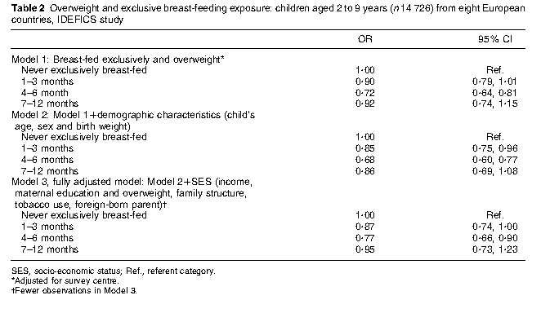
Findings
Notes:
In our fully adjusted model, with country as a random effect, we found 4-6 months to offer the most protection, with an OR of .77 –reduced risk of overweight about 25%

Slide 18

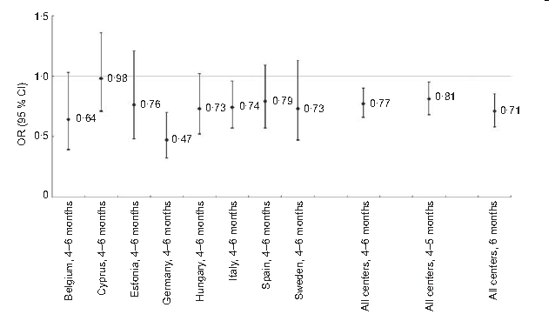
Findings across survey center countries

Slide 19
Children consuming milk cereal drink are at increased risk for overweight- the IDEFICS Sweden study
A common complementary food offered mainly in Sweden is “välling”, a milk cereal drink (MCD) that has been consumed for hundreds of years and sold as a ready-made mix since the 1940’s.
The Swedish National Food Administration recommends iron fortified MCD or porridge be served on a daily basis from the age of six months to ensure a sufficient iron intake.
To our knowledge, only one previous study has investigated MCD consumption and associations with overweight, reporting that infants’ consumption of MCD at six months of age increased the risk of a high body mass index (BMI) at 12 and 18 months (Almqvist-Tangen G, Dahlgren J, Roswall J, et alMilk cereal drink increases BMI risk at 12 and 18 months, but formula does not. Acta Paediatr 2013. Epub ahead of print Sep 13 2013. DOI: 10.1111/apa.12418. )
Wiberger, M ,Eiben G, Lissner L, Mehlig K, Papoutsou S and Hunsberger M. on behalf of the IDEFICS Consortium
The online version of this article can be found at: DOI: 10.1177/1403494814538124 published online 19 June 2014 Scand J Public Health
Notes:
But we know that the majority are offered solids before 6 months

Slide 20
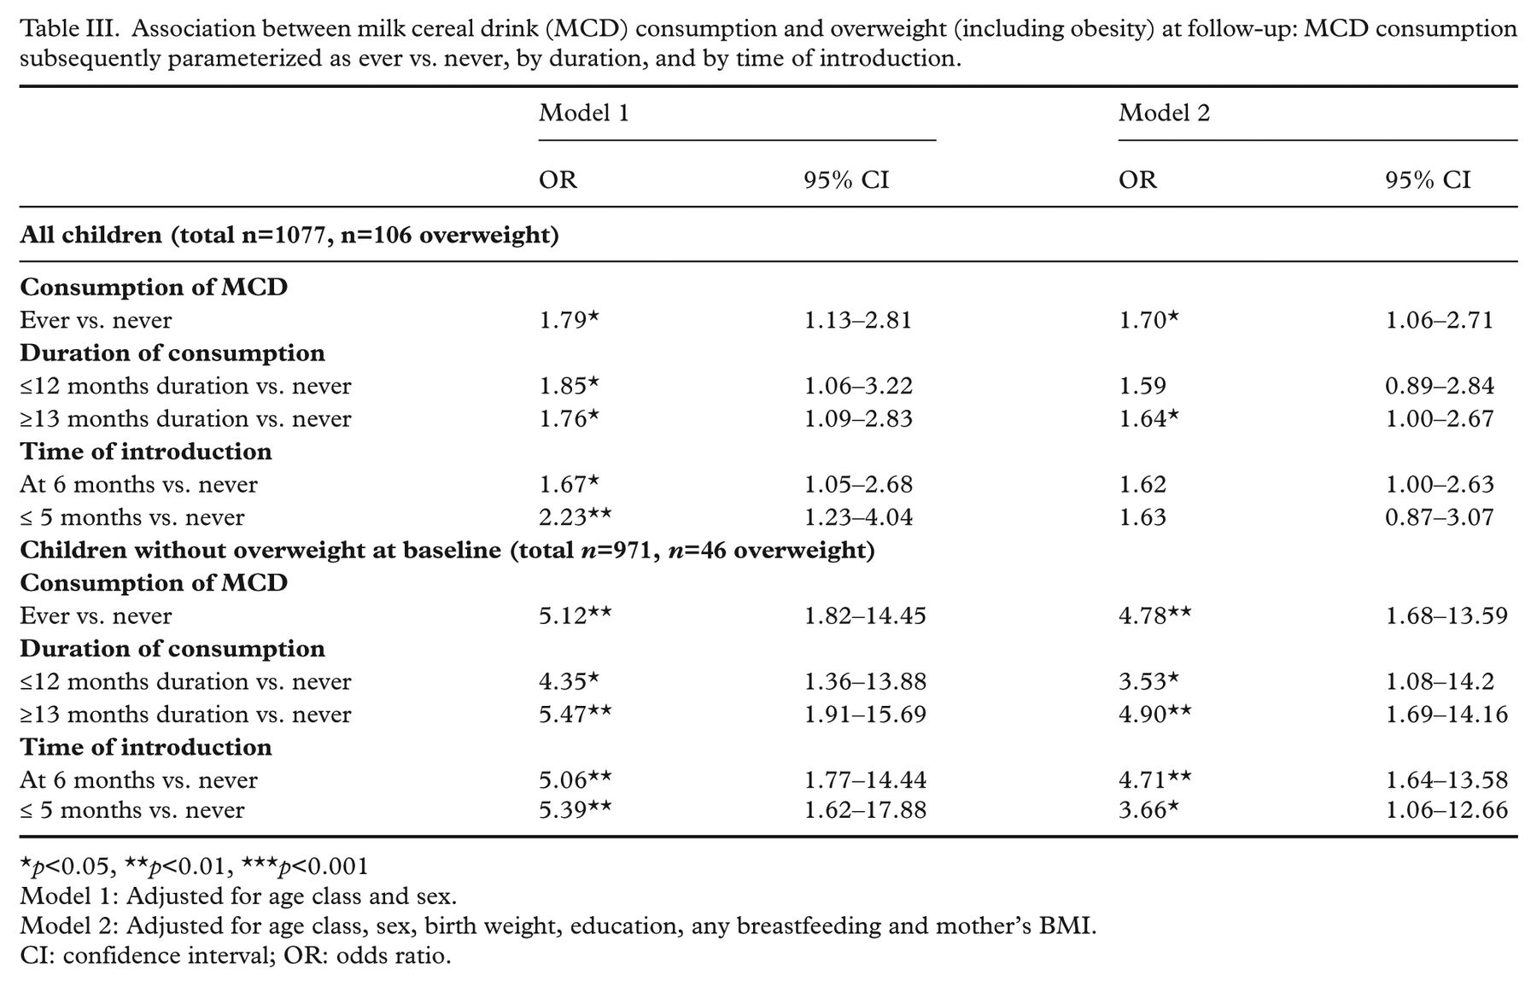

Maja Wiberger et al. Scand J Public Health 2014;42:518-524
Copyright © by Associations of Public Health in the Nordic Countries Regions
Notes:
Association between milk cereal drink (MCD) consumption and overweight (including obesity) at follow-up: MCD consumption subsequently parameterized as ever vs. never, by duration, and by time of introduction.

Slide 21
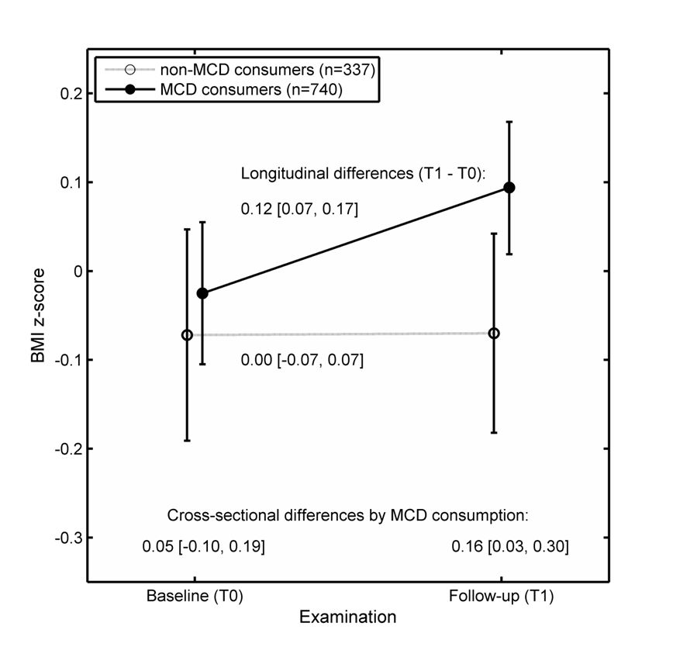
Our Findings MCD

Slide 22
TIMING OF SOLID FOOD INTRODUCTION AND ASSOCIATION WITH LATER CHILDHOOD OBESITY: THE IDEFICS STUDY (under review)
Logistic regression models to evaluate the association of overweight in children with timing of introduction for five food groups
Model 1: adjusted for age, sex, country, birth weight, parental higher level of education (cat) and tobacco use in pregnancy (cat)
Model 2: Model 1 plus adjustment for self-reported maternal BMI, self-reported paternal BMI and total BF duration in months
† Cereals or food containing rye, wheat or barley, *p=0.06
 | Cereals† | Vegetables | Fruits | Meat | Cow milk
Time of introduction
Model 1 | n=11089 | n=11094 | n=11107 | n=11088 | n=10365
1-3 months | 0.93 (0.67-1.29) | 0.89 (0.70-1.13) | 0.78 (0.66-0.93) | 1.27 (0.76-2.14) | 1.2 (0.77-1.86)
4-6 months | 1 (ref) | 1 (ref) | 1 (ref) | 1 (ref) | 1 (ref)
7+ months | 1.19 (1.07-1.31) | 1.30 (1.16-1.45) | 0.95 (0.84-1.07) | 1.01 (0.92-1.12) | 1.14 (0.96-1.35)
Model 2 | n=9713 | n=9715 | n=9727 | n=9714 | n=9097
1-3 months | 0.95 (0.64-1.36) | 0.92 (0.70-1.21) | 0.75 (0.61-0.91) | 1.74 (0.96-3.2)* | 1.16 (0.69-1.94)
4-6 months | 1 (ref) | 1 (ref) | 1 (ref) | 1 (ref) | 1 (ref)
7+ months | 1.15 (1.03-1.29) | 1.35 (1.19-1.52) | 0.95 (0.83-1.1) | 1.06 (0.95-1.18) | 1.12 (0.92-1.35)
Notes:
Suggests that early introduction of fruits could offer protection

Slide 23
Timing of solid food introduction and obesity: Hong Kong's "children of 1997" birth cohort.
METHODS:
Examined timing of the introduction of solid food (<3, 3-4, 5-6, 7-8, and >8 months) with BMI z score and overweight at different growth phases (infancy, childhood, and puberty) in 7809 children (88% follow-up) from a Chinese birth cohort, "Children of 1997."
RESULTS:
The introduction of solid food at <3 months of age was associated with lower family socioeconomic position (SEP) but was not clearly associated with BMI or overweight (including obesity) in infancy [mean difference in BMI z score: 0.01; 95% confidence interval (CI): -0.14 to 0.17], childhood (0.14; 95% CI: -0.11 to 0.40), or at puberty (0.22; 95% CI: -0.07 to 0.52), adjusted for SEP and infant and maternal characteristics.
CONCLUSIONS:
In a non-Western developed setting, there was no clear association of the early introduction of solid food with childhood obesity.
Pediatrics. 2013 May;131(5):e1459-67. doi: 10.1542/peds.2012-2643. Epub 2013 Apr 8.
Lin SL¹, Leung GM, Lam TH, Schooling CM.
Notes:
Together with the inconsistent evidence from studies in Western settings, this finding suggests that any observed associations might simply be residual confounding by SEP.

Slide 24
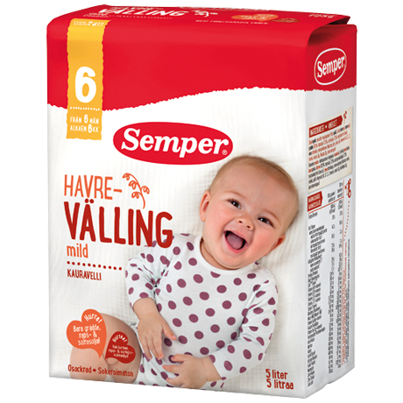
Our ongoing research I.Family
Further investigation of välling use in Swedish Cohort
Hypothesize may displace other foods in the diet and offered for reasons other than hunger
  How välling is offered (bottle, mug, bowl)
  When, frequency, type
“Between 1984 and 1996, Sweden experienced an “epidemic” of clinical celiac disease in children ,2 years of age, attributed partly to changes in infant feeding.”
Ivarsson, A, et al.
Pediatrics 2013;131:e687–e694
“If your child gets small amounts of gluten while he or she is still being breastfed, the risk of becoming gluten intolerant decreases. “
“By four months at the earliest, and six months at the latest, you should therefore start giving your child a little food with gluten. “
“Gluten is found in food containing wheat, barley, and rye, but there is only a little gluten in oats. “

Slide 25
Conclusions
The study of early feeding exposures may suffer from recall bias
It may be difficult to separate “just a taste” from “feeding”
The recommendation to exclusively BF for 6 months may mean different things to different people
Introduction to solids and overweight – not clear
  No association -To Formula fed at increased risk but not BF
    Huh SY, Rifas-Shiman SL, Taveras EM, Oken E, Gillman MW.Pediatrics. 2011 Mar;127(3):e544-51. doi: 10.1542/peds.2010-0740. Epub 2011 Feb 7.

Slide 26
Conclusions from 2013 review (2)
The timing of introduction of complementary foods and later health.
“….. while possible long-term effects may relate to obesity, cardiovascular disease, autoimmunity (celiac disease and type 1 diabetes) and atopic disorders. For most of these it is impossible on the basis of the available evidence to conclude on the age when risks related to the start of complementary feeding are lowest or highest, with the possible exception of infections and early growth velocity. For undesirable health consequences, whilst potential mechanisms are recognized, the evidence from mostly observational studies is insufficient….. While the 6-month goal is desirable, introduction of suitable complementary food after 4 completed months with ongoing breastfeeding can be considered without adverse health consequences for infants living in affluent countries.
Even less evidence on the consequences of the timing of complementary food introduction is available for formula-fed infants.”
Agostoni C, Przyrembel H. World Rev Nutr Diet. 2013;108:63-70.
Notes:
In a 2013 review Agostoni and Przyrembel concluded the evidence from mostly observational studies is insufficient

